Slide 1
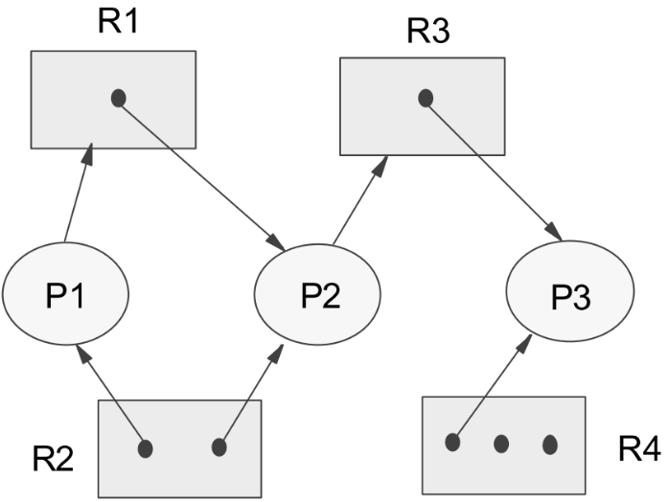
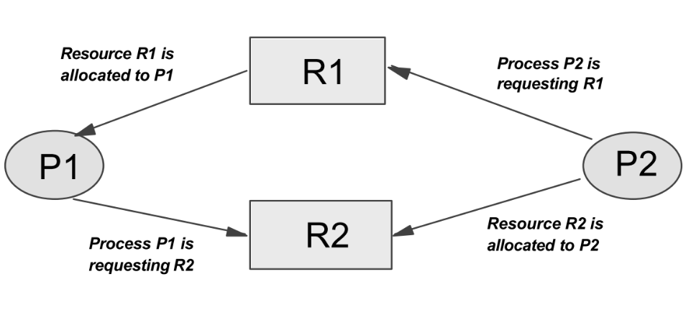
Lecture 5
Deadlocks
Borko Furht
Florida Atlantic University

Slide 2
System Concept
A system consists of a finite number of resources to be distributed among a number of competing processes.
Resource types: memory space, CPU cycles, files, I/O devices.
Several instances of the same resource type: two CPUs, five printers, etc.
A process must request a resource before using it, and must release the resource after using it.
The number of resources requested by a process cannot exceed the number of available resources.

Slide 3
Normal Mode of Operation
REQUEST. If the request cannot be granted immediately (resource is busy), then the requesting process must wait.
USE. The process can operate on the resource.
RELEASE. The process releases the resource.
Examples of system calls: request and release device, open and close file, and allocate and free memory.

Slide 4
Deadlock Definition
A process is in a deadlock state, if it is waiting for a particular event that will never occur.
In a deadlock, processes never finish executing and system resources are tied up, preventing other jobs from ever starting.

Slide 5
Necessary Conditions for a Deadlock
Mutual exclusion condition - At least one resource must be held in a non-sharable mode. If another process requests that resource, it must wait until the resource has been released.
Hold and wait condition - There must exist a process that is holding at least one resource and is waiting to acquire additional resources, currently being held by other processes.
No preemption condition - Resources cannot be preempted before the process completes the task.
Circular wait condition - There must exist set of processes {P0,P1,..Pn} of waiting processes, such that P0 is waiting for a resource that is held by P1, P1 is waiting for a resource held by P2, etc.

Slide 6
Resource Allocation Graph
Set of vertices (V) and set of edges (E)
The set of vertices V is partitioned into tow types: processes P{P1,P2,...Pn}, and set of resources R + {R1,R2,...Rm}.
A directed edge Pi --> Rj - process Pi requested an instance of resource type Rj, and is currently waiting for the resource (request edge).
A directed edge Rj-->Pi - an instance of resource type Rj has been allocated to process Pi (assignment edge).

Slide 7
Example of Resource Allocation Graph

Slide 8
Methods for Handling Deadlocks
Deadlock prevention - remove any possibility of deadlock occurring. However, prevention methods often result in poor resource utilization.
Deadlock avoidance - less stringent conditions than in deadlock prevention in order to get better resource utilization.
Deadlock detection - the system allows the deadlocks to occur. Determine processes and resources involved in the deadlock.
Deadlock recovery - to clear the deadlock from the system (flushing one or more processes from the system, and restarting them later).

Slide 9
Deadlock Prevention
By preventing one of the deadlock conditions
Three strategies that deny conditions:
Hold and Wait
No preemption
Circular wait

Slide 10
Deadlock Prevention – Denying “Hold and Wait” Condition
Each process must request all its required resources at once and cannot proceed until all have been granted.
If all the needed resources are not available, the process must wait.
Serious waste of resources (example of a program requiring 10 tape drives: one at the beginning and 9 later in the program - must wait for all 10!)
Better resource utilization - divide the program into several program steps that run relatively independently of one another.

Slide 11
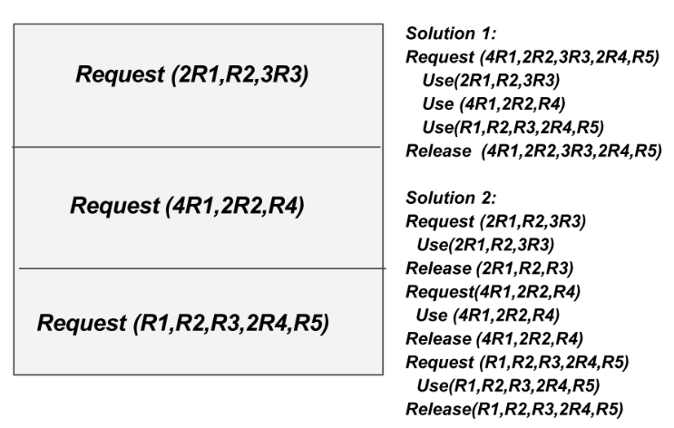
Examples of Denying “Hold and Wait” Condition

Slide 12
Denying “No Preemptive” Condition
If a process holding certain resources is denied a further request, that process must release its original resources and, if necessary, request them again together with the additional resources.
When a process releases resources may lose all its work.
Serious consequence can be - indefinite postponement.

Slide 13
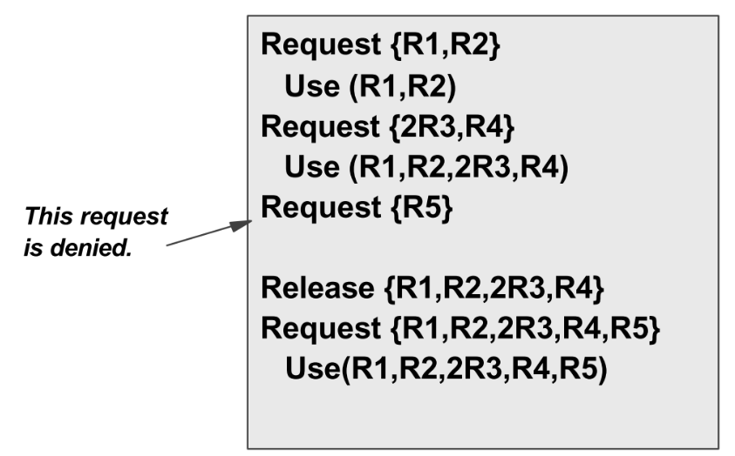
Examples of Denying “No Preemption” Condition

Slide 14
Denying the “Circular Wait” Condition
Impose a linear ordering of resource types on all processes.
All resources are uniquely numbered, and processes must request resources in linear ascending order - a circular wait cannot develop.
This is a popular strategy implemented in many OS.
For jobs matching the ordering, efficient operation may be expected.
For jobs that need the resources in a different order than one assumed at the installation, the execution will not be efficient (waste of resources).

Slide 15
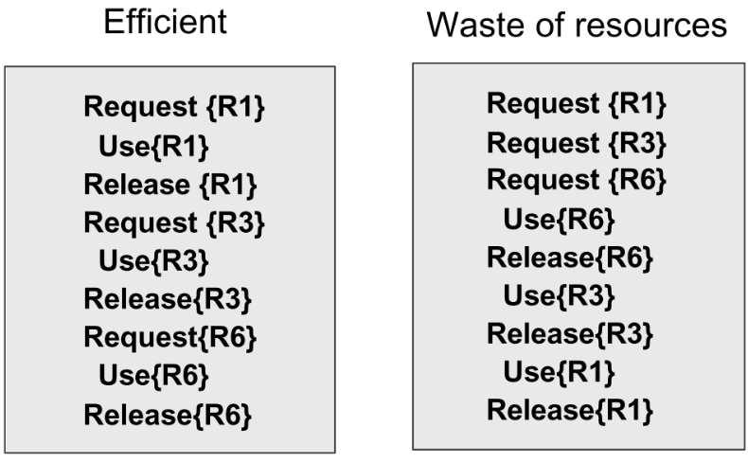
Example of Denying the “Circular Wait” Condition

Slide 16
Deadlock Avoidance Dijakstra’s Banker’s Algorithm
For the resources of the same type. Can be extended to pools of resources of several different types.
Example: A system with u users and t resources of the same type (t tape drives).
Every user submits a request of maximum need for tape drives. It must be less or equal than t.
SAFE state - the OS allows all current users to complete their jobs within a finite time.
UNSAFE state - if the current users cannot complete their jobs.

Slide 17
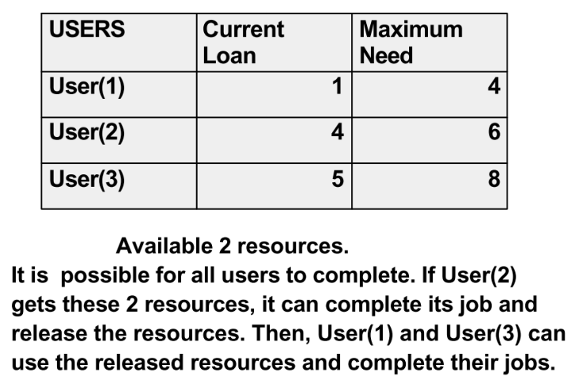
Example of a Safe State
System has t=12 tape drives, and u=3.

Slide 18
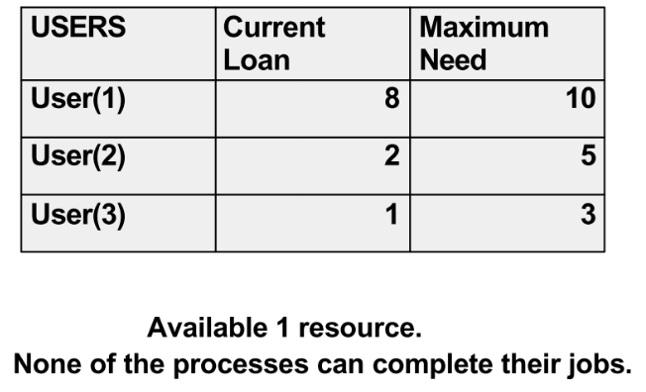
Example of a Unsafe State
System has t=12 tape drives, and u=3.

Slide 19
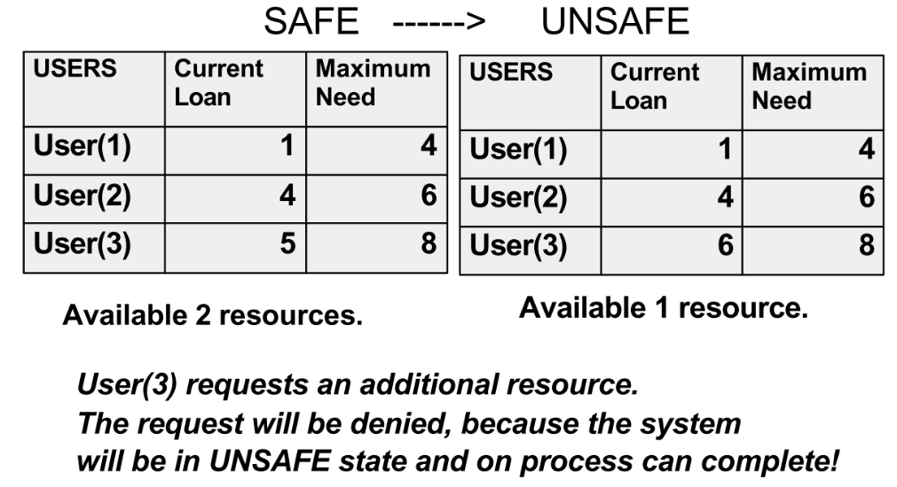
Example of Safe State to Unsafe State Transition
System has t=12 tape drives, and u=3.

Slide 20
Banker’s Algorithm
All conditions for the deadlock are allowed.
The system grants requests that result in safe states only.
A user's request that would result in an unsafe state is denied until it can be satisfied.

Slide 21
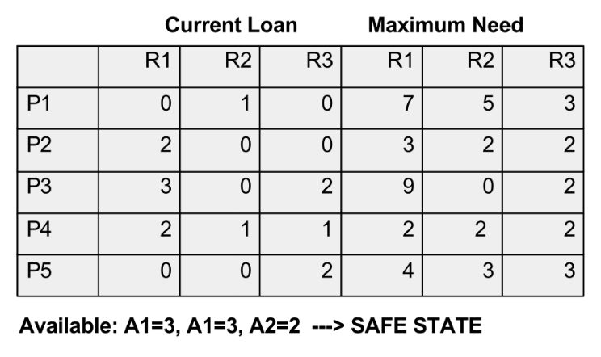
Banker’s Algorithm for Pool of Resources of Different Types
Consider a system with five processes (P1,P2,..P5}, and three resources {R1,R2,R3}.
Number of available resources: N1=10 instances, N2=5, and N3=7.

Slide 22
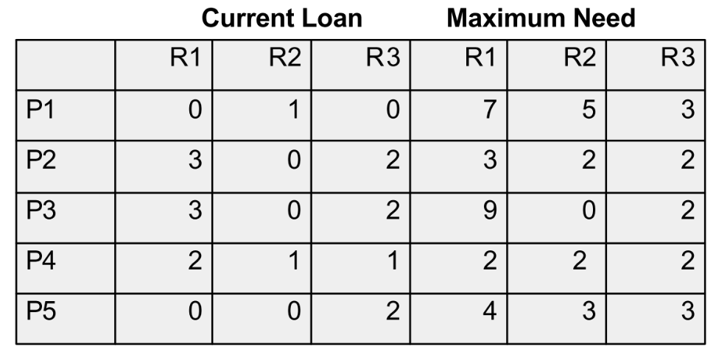
Resources of Different Types
Suppose that process P2 requests additional instance of resource R1 and two instances of resource R3. Request=(1,0,2).
Can be this request immediately granted?

Slide 23
Deadlock Detection
If the system does not employ a deadlock prevention or a deadlock avoidance algorithm, then a deadlock situation may occur.
The system must provide an algorithm that examines the state of the system to determine whether a deadlock has occurred.
The system must also provide an algorithm to recover from the deadlock.

Slide 24
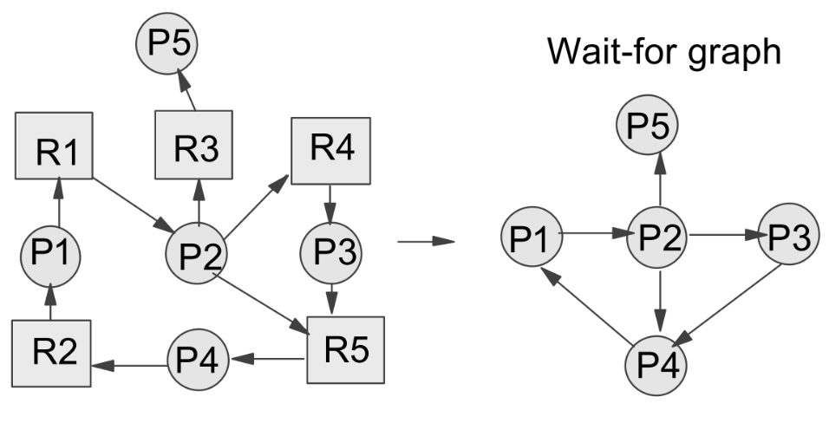
Deadlock Detection – Single Instances of Each Resource Type
The algorithm uses a Wait-for graph that can be obtained from the resource allocation graph by removing the nodes of type resource and collapsing the appropriate edges.

Slide 25
Deadlock Analysis
A deadlock exists in the system if the wait-for graph contains a cycle.
The system needs to maintain the wait-for graph and periodically to invoke an algorithm that searches for a cycle in the graph.
In the previous example, the cycle exists {P1,P2,P3,P4}, and the system is in the deadlock.

Slide 26
Reduction of Resource Allocation Graphs
The algorithm determines the processes that may complete and the processes that will remain deadlocked.
If the requests for resources from a process can be granted, the graph can be reduced by that process.
The reduction means that this process can return the resources to the system (removing the arrows in the graph).

Slide 27
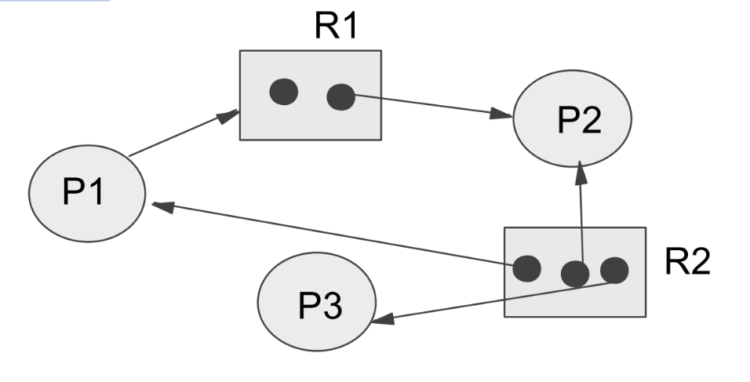
Graph Reduction Algorithm
If a graph can be reduced by all its processes, then there is no deadlock.
If the graph cannot be reduced by all its processes, then the remaining processes constitute the set of deadlocked processes.

Slide 28
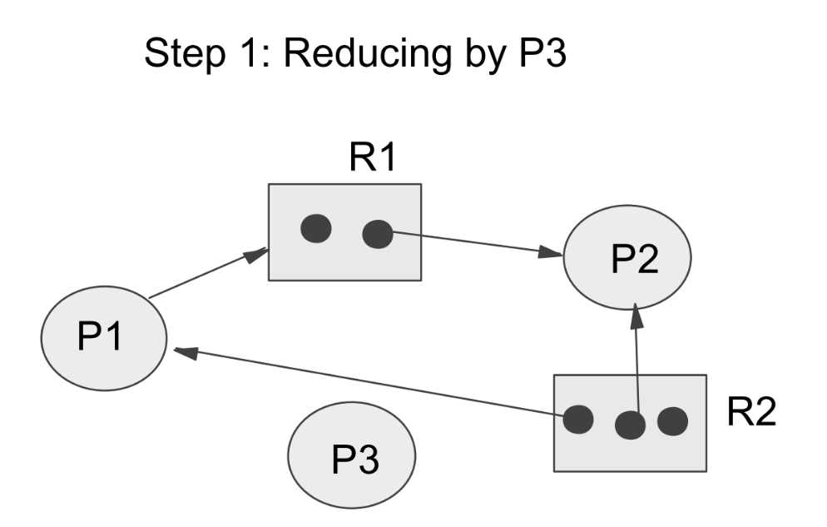
Graph Reduction Algorithm

Slide 29
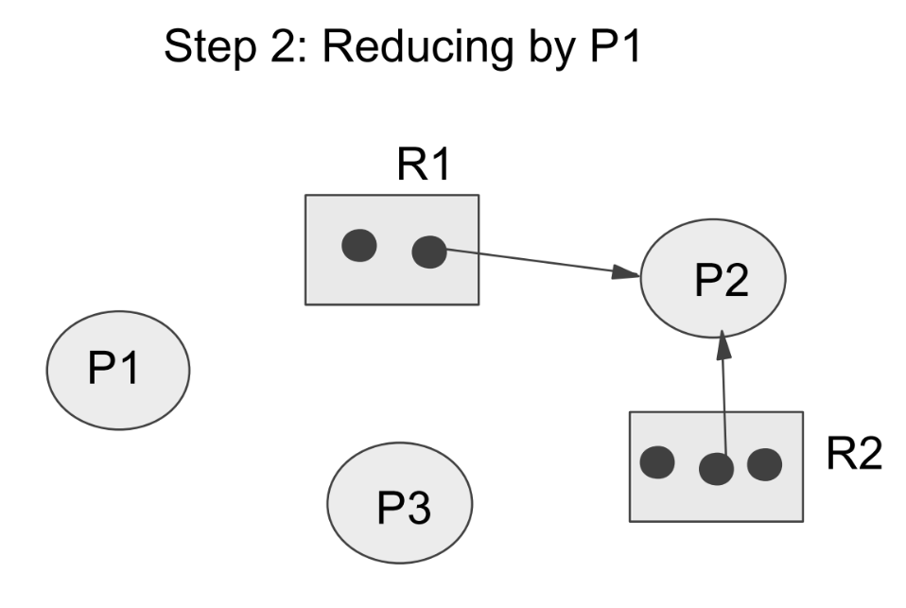
Graph Reducing Algorithm

Slide 30
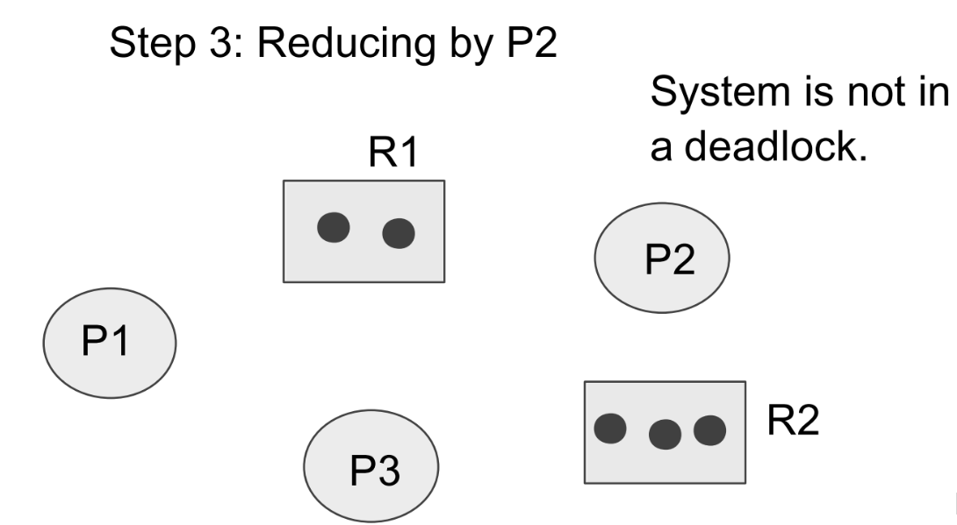
Graph Reducing Algorithm

Slide 31
Usage of a Deadlock Detection Algorithm
How often is a deadlock likely to occur?
How many processes will be affected by deadlock when it happens?
If deadlocks occur frequently, then the detection algorithm should be invoked frequently.
Invoking the detection algorithm for every request may incur a considerable overhead.
Less expensive alternatives - once per hour, or whenever CPU utilization drops below 40%.

Slide 32
Deadlock Recovery
Manual recovery - the system will inform the operator that a deadlock exists.
Automatic recovery - two solutions.
Solution 1 - abort one or more processes to break the circular wait.
Solution 2 - preempt some resources from one or more of the deadlocked processes.

Slide 33
Process Termination
Abort all deadlocked processes or
Abort one process at a time until the deadlock cycle is eliminated - considerable overhead.
Aborting a process may not be easy (if the process was in the middle of updating a file or of printing data).

Slide 34
Resource Preemption
Preempt some resources from processes and give these resources to other processes until the deadlock cycle is broken.
Issue 1: selecting victim processes.
Issue 2: rollback - if we preempt a resource from a process, what should be done with that process? We must roll back the process to some safe state, and restart from that state. The simplest solution is a total rollback -- abort the process and then restart.
Issue 3: starvation - how can we guarantee that resources will not always be preempted from the same process?

Slide 35
Combined Approach for Deadlock Handling
Combine basic approaches (prevention, avoidance, and detection). Use optimal approach for each class of resources in the system.
Within each class, one of the basic approaches is used.
Four class of resources: internal resources, central memory, job resources, and swappable space.

Slide 36
Combined Technique
Internal resources (such as PCB) - prevention through resource ordering can be used.
Central memory - prevention through preemption can be used, since a job can always be swapped out, and the central memory can be preempted.
Job resources (such as tape drive and files) avoidance can be used.
Swappable space (space for each user job on the disk) - preallocation can be used, since the maximum storage requirements are usually known.

